Slide 2
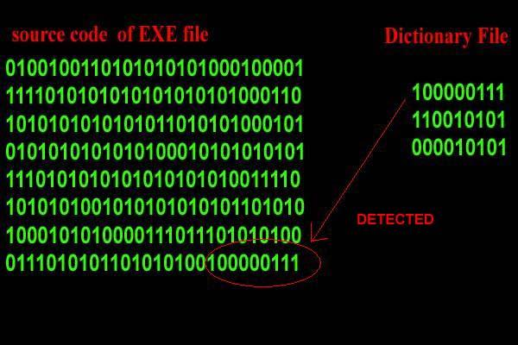
What is an Antivirus?
Anti-virus software is used to protect a computer from malware.
Viruses detect malware by signatures i.e pattern of data that is known to be related to already identified malware.

Slide 3
What is an Antivirus?
Antiviruses can also use Heuristic methods i.e predicting a file is malicious by studying its behavior.
Sandbox Testing - the file is allowed to run in a controlled virtual system to see what it does.
Can result in a false positive - a legit program classified as malware.

Slide 4
Antivirus Operations
On Access Scanning - The antivirus checks every file or program that is opened.
Full System Scan
Polymorphic virus - A virus that morphs or changes its code making it very difficult to be detected.

Slide 5
Antivirus Software
Antiviruses differ in their detection rates.
System resources usage.

